Slide 1
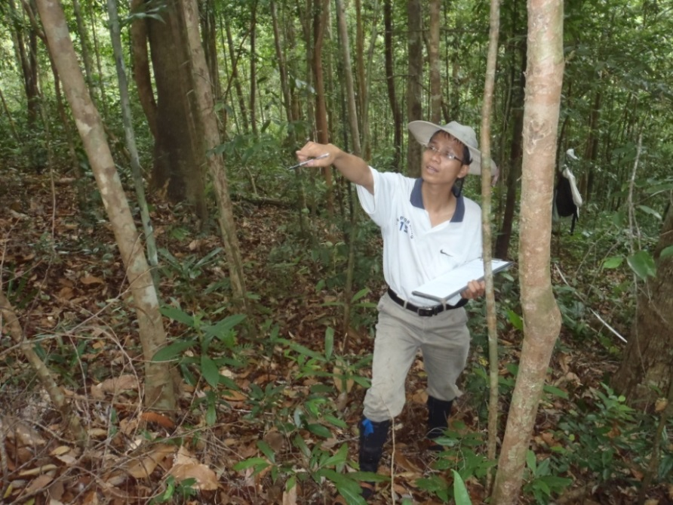
Module 2.4 Incorporating community based monitoring in national (or jurisdictional) REDD+ monitoring
Module developer:
Margaret Skutsch, Universidad Nacional Autónoma de Mexico
Arturo Balderas Torres, Universidad Nacional Autónoma de Mexico
Country example: NEPAL
V1, May 2015
Creative Commons License

Slide 2
Background information
A report on carbon stocks in this project can be found at:
http://www.ansab.org/publication/forest-carbon-stock-in-community-forests-in-three-watersheds-ludikhola-kayarkhola-and-charnawati/
The guide for community carbon measurement in this project can be found at:
http://www.forestrynepal.org/publications/book/4772

Slide 3
Community forest management
Nepal has a long history of community forest management; 25% of all forests in Nepal are managed by local people
It is done at sub-village level, through ´Forest User Groups´ (FUG), which are groups of around 10-25 families
FUGs are autonomous, self-governing organisations
Each FUG is allocated a certain part of the forest, and there are quotas for the amount of forest products each family is allowed, and sometimes seasonal restrictions are also present
In these areas, deforestation and degradation has been halted, and the forests are beginning to regrow (forest enhancement)

Slide 4
NORAD funded pilot REDD+ project
Because of this long and largely positive experience, NORAD funded a pilot REDD+ project in Nepal in three watersheds
The project is managed by ICIMOD and is being carried out in collaboration with FECOFUN, a national NGO which supports the FUGs and fights for their rights, and ANSAB, an Asian-based environmental NGO
Among other things, the project trained members of FUGs to do biomass measurements to monitor the growth of trees and shrubs in their forests

Slide 5
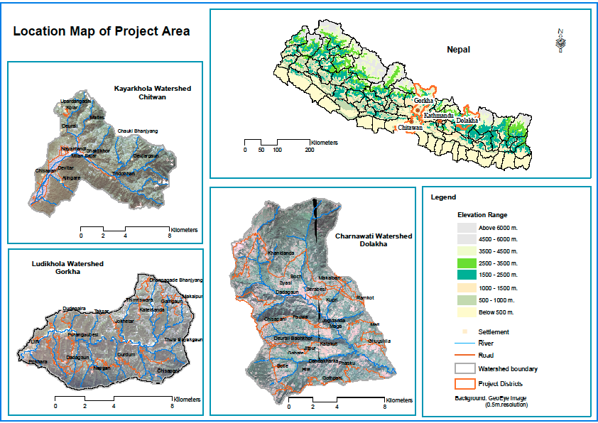
Location of the project
Map courtesy of Norad/ICIMOD/Fecofun/ANSAB

Slide 6
REDD+ pilot project in Nepal
This 10 minute video shows local communities in the project doing carbon monitoring using the kinds of tree measuring equipment that is explained in this course and in our manual
It involves people with a very low level of education
http://www.youtube.com/watch?v=VjfTF9sVtxo
Notes:
Note: In the video it is said that according to the IPCC deforestation and forest degradation contribute about 20% of global GHG emissions annually. These numbers, however, have been updated in the newest IPCC report of 2014. The Agriculture, Forestry and Other Land Use (AFOLU) sector includes land-based CO2 emissions from forest fires, peat fires and peat decay that approximate to net CO2 flux from the Forestry and Other Land Use (FOLU) sub-sector (also referred to as LULUCF – Land Use, Land-Use Change, and Forestry – a sub-set from AFOLU). In 2014, the AFOLU sector contributed 24% to the total GHG emissions annually.

Slide 7
REDD+ pilot project in Nepal
It is important to understand that this is an example of monitoring at project level, not at national level
The project was carried out to demonstrate, among other things, the capacity of FUGs to do this measurement
As well as to demonstrate how much carbon levels increase when forests are managed in this way
The FUGs had all been managing their forests for several years already, it was just the carbon measurements that were new
As yet, the data has not been integrated into a national level data base

Slide 8
Distribution of benefits
Interestingly, the data on carbon stock increases has been used in part to determine the distribution of benefits to the FUGs
The total funding available for distribution of benefits is not based on the total carbon savings (as it would be in a fully performance based REDD+ scheme): a lump sum was agreed before the project started, and this had to be distributed between the participating FUGs
A weighted formula was developed such that the amount received by each participating FUGs depends for
60% on the level of poverty of the members
24% on the total stock in the forest
16% on the measured increment

Slide 9
Discussion points
Nepali community forest management is carried out by small groups (FUGs) which are independent of political structures at local level
FUGs are also supported by a national level union (independent of government)
What are the advantages and disadvantages?
Is this a model that could easily be replicated in other countries?
Benefit distribution is skewed towards the poor, who essentially get paid more per ton of carbon saved than the rich
Discuss this from the point of view of (a) ethics and (b) environmental efficiency

